Slide 1
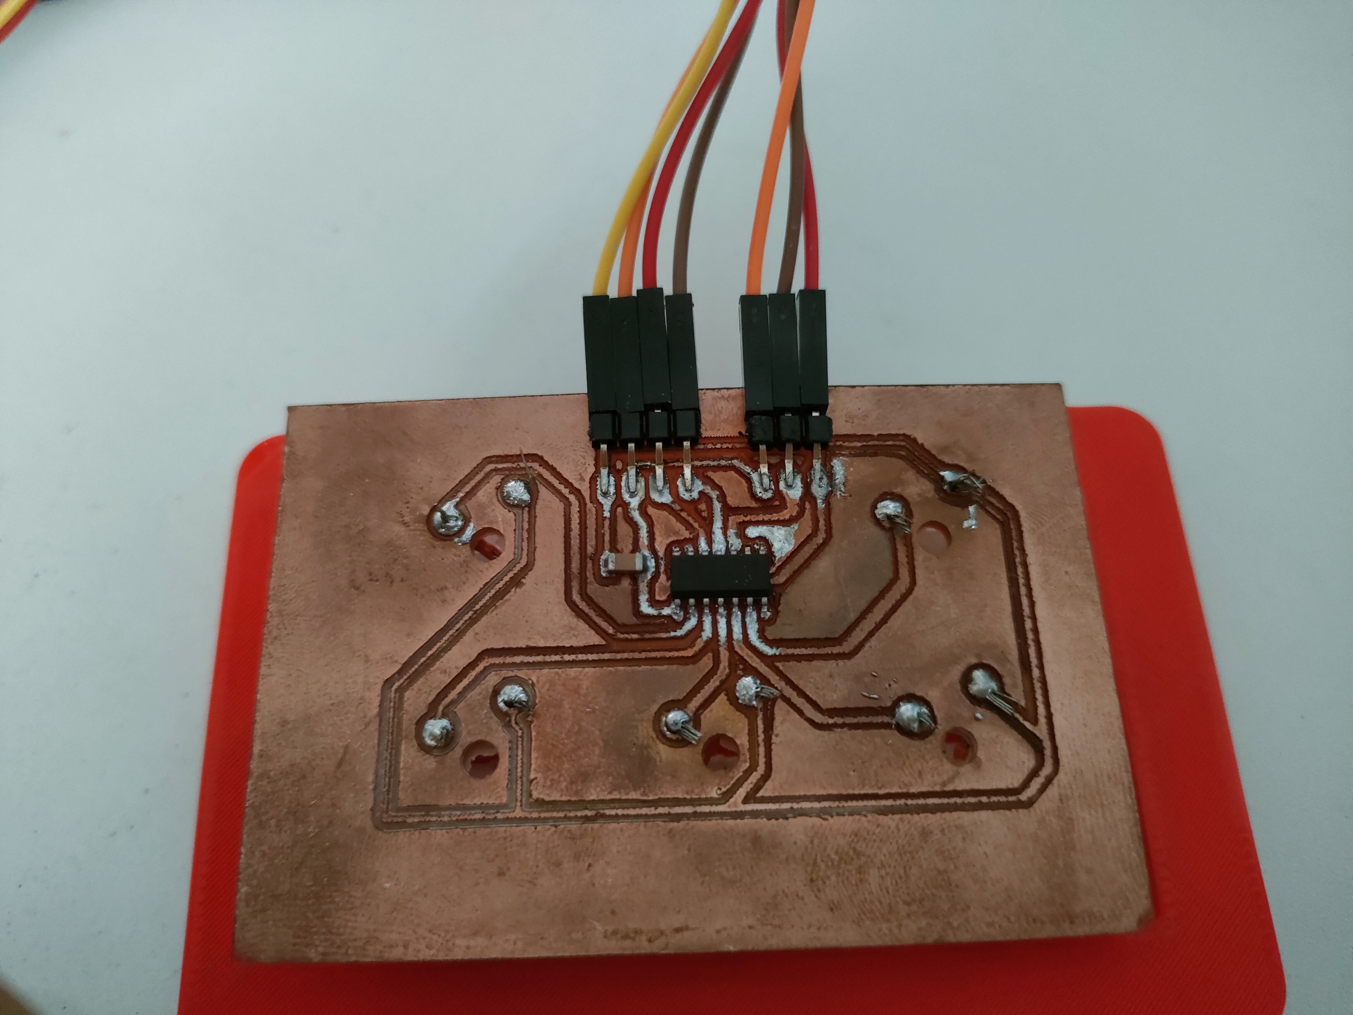
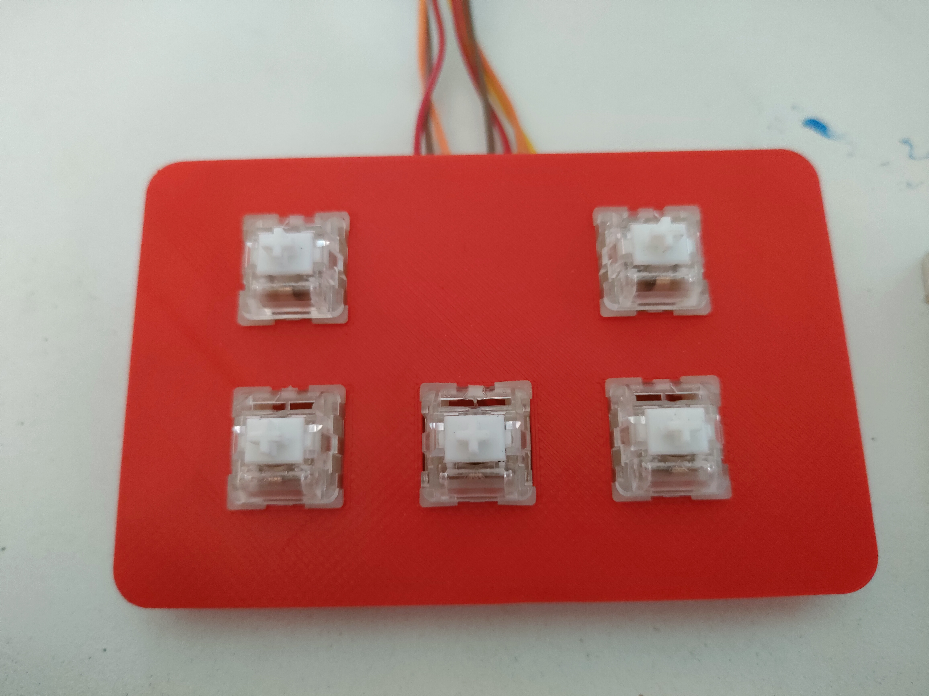
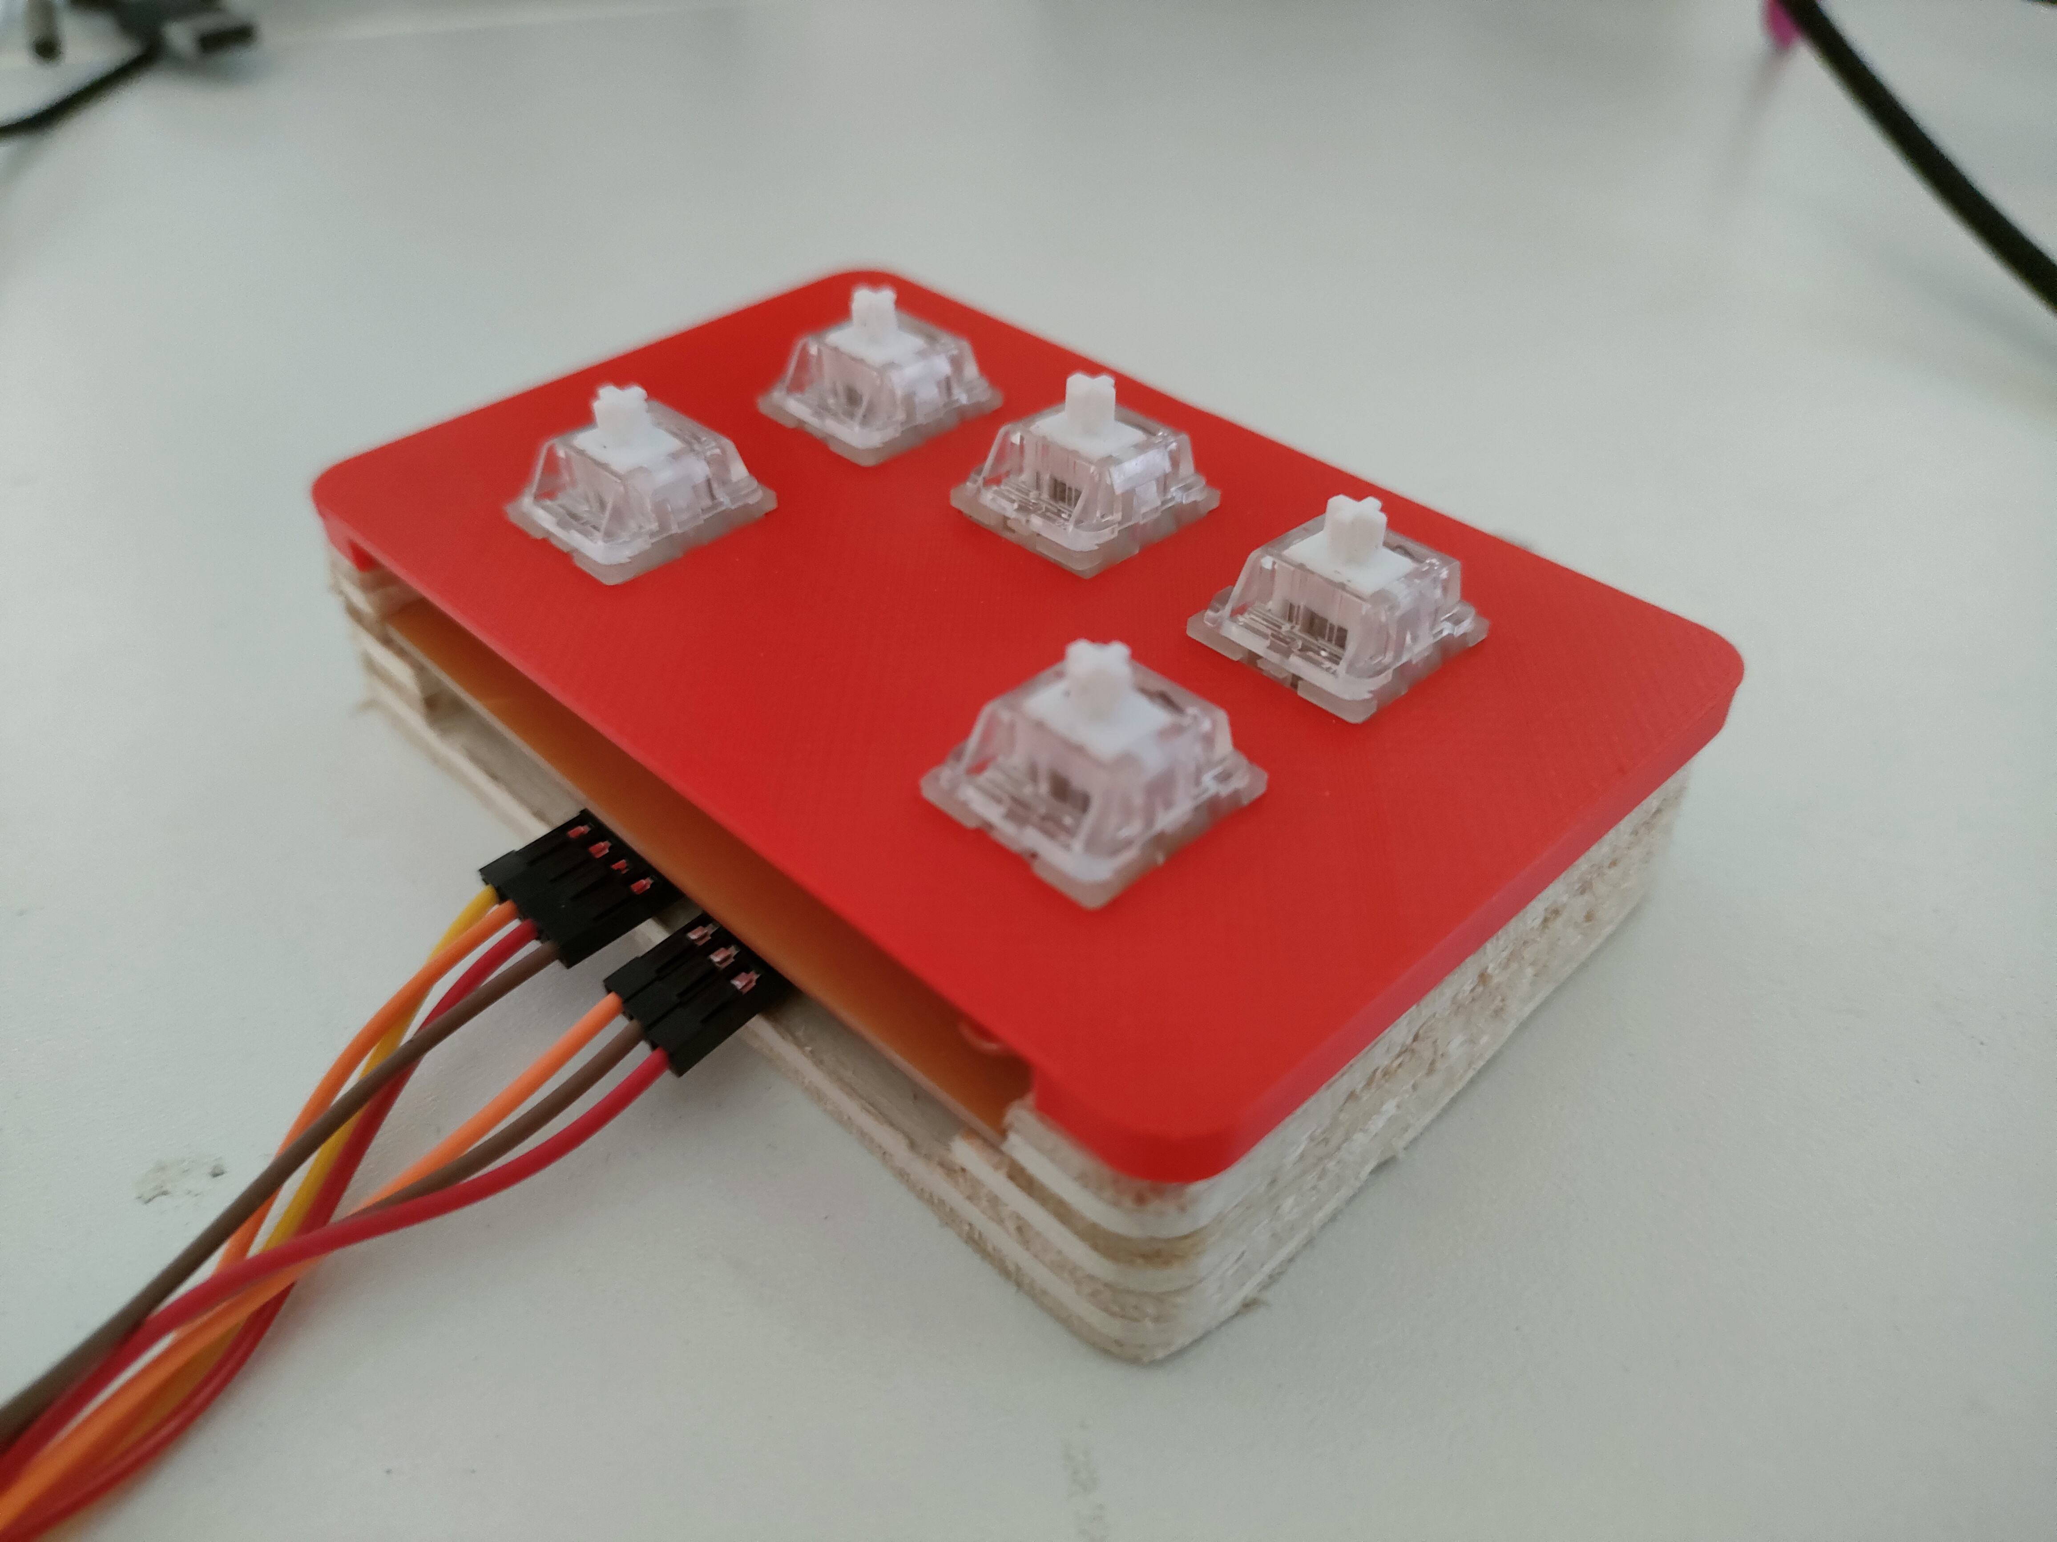
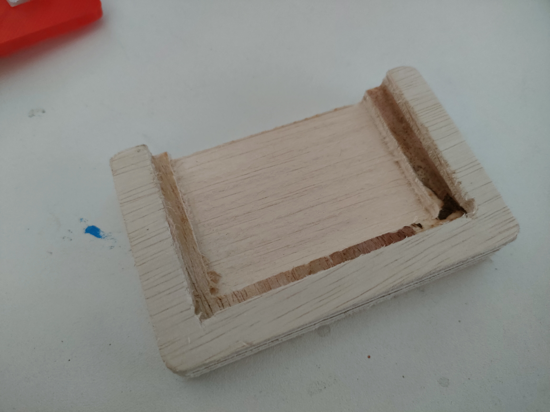
The KeyPad
Keypad PCB
-Has a ATtiny1614, 4 pin and 3 pin surface mounted connectors
-Through holes to solder switches to the PCB and connect to the microcontroller
3D printed Plate
-Holds the keypad switches in place
CNC routed housing
-Houses the PCB and wires

